Slide 1
Matrike v C#

Slide 2


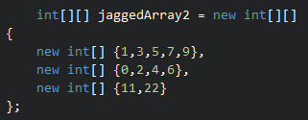
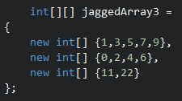
Jagged arrays (tabela tabel)

Slide 3


Multidimenzijske tabele

Slide 4
int[,] A = new int[6,7]
A.Length -> 42
A.GetLength(0) -> 6
A.GetLength(1) -> 7

Slide 5
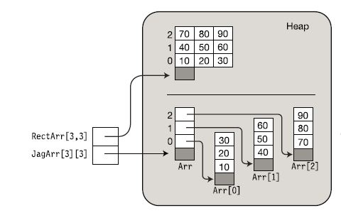

Slide 6
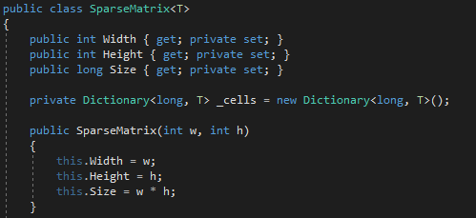
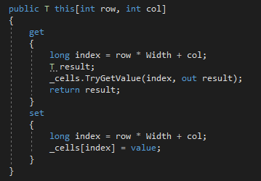

Slide 7




Slide 8
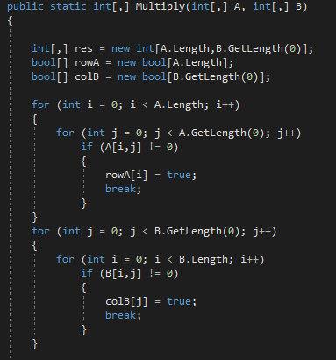
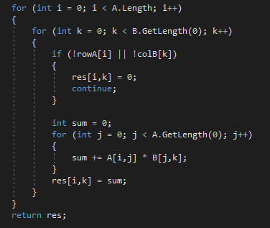

Slide 9
Viri
https://docs.microsoft.com/en-us/dotnet/csharp/programming-guide/arrays/jagged-arrays
https://docs.microsoft.com/en-us/dotnet/csharp/programming-guide/arrays/multidimensional-arrays
https://stackoverflow.com/questions/597720/what-are-the-differences-between-a-multidimensional-array-and-an-array-of-arrays
https://stackoverflow.com/questions/756329/best-way-to-store-a-sparse-matrix-in-net

